Slide 1
Questions
What are the accuracies of NDB, VOR and ILS?
What are factors to be considered in the design of flight procedures?
What are the five categories of aircraft speed?
What are the five segments of an approach procedure?
What is the difference between a precision approach and a non-precision approach?
How is Decision Altitude determined?
What are the different types of reversal procedures?
What are the elements that defines a holding pattern?
What is the use of Minimum Sector Altitude?
Describe the arrival route to Tianjin Binhai airport runway 16R.
Describe the approach procedure to Tianjin Binhai airport runway 16R.

Slide 2
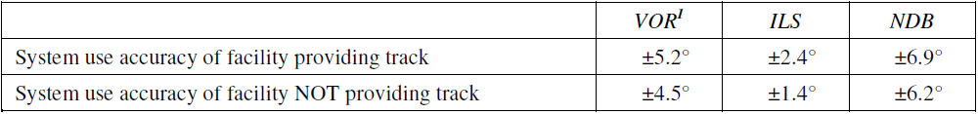
ACCURACY OF TRACK GUIDANCE

Slide 3
IFR
Instrument Flight Procedure
For: Airways/STARs/Approaches/Departures/SIDs
Which is
Operable for all relevant aircraft
Protected from obstacles and other traffic
Which considers
Aircraft performance
Ground Navigational facilities
Environment (Terrain, communities, etc)

Slide 4
CATEGORIES OF AIRCRAFT
Aircraft performance has a direct effect on the airspace and visibility required for the various maneuvers associated with the conduct of instrument approach procedures. The most significant performance factor is aircraft speed.
Accordingly, categories of typical aircraft have been established. These categories provide a standardized basis for relating aircraft maneuverability to specific instrument approach procedures. For precision approach procedures, the dimensions of the aircraft are also a factor for the calculation of the obstacle clearance height (OCH).
Category A: less than 169 km/h (91 kt) indicated airspeed (IAS)
Category B: 169 km/h (91 kt) or more but less than 224 km/h (121 kt) IAS
Category C: 224 km/h (121 kt) or more but less than 261 km/h (141 kt) IAS
Category D: 261 km/h (141 kt) or more but less than 307 km/h (166 kt) IAS
Category E: 307 km/h (166 kt) or more but less than 391 km/h (211 kt) IAS
Category H: “Helicopters”.

Slide 5
What are the five segments of an approach procedure?
Arrival Segment
INITIAL APPROACH SEGMENT
INTERMEDIATE APPROACH SEGMENT
FINAL APPROACH SEGMENT
MISSED APPROACH SEGMENT

Slide 6
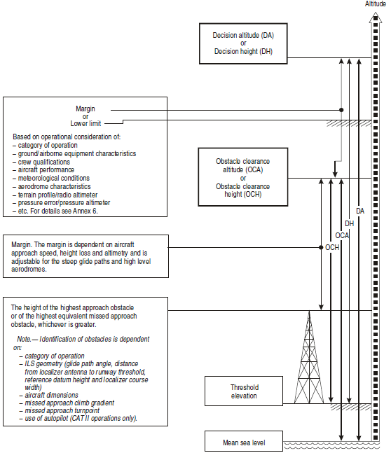
Precision Approach and Decision Altitude

Slide 7
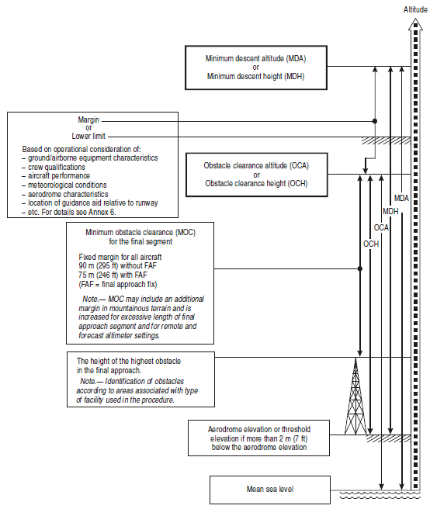
Non-Precision Approach and Minimum Descent Altitude

Slide 8
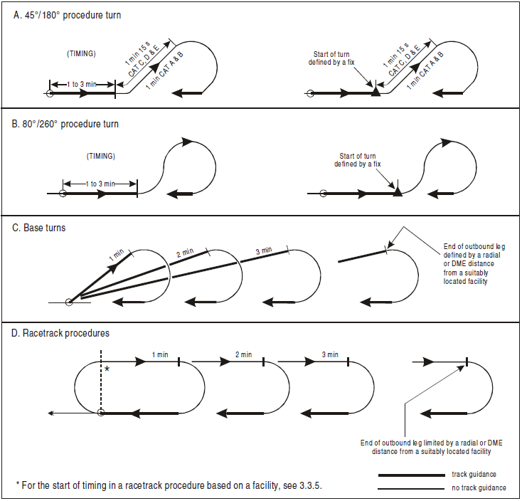
TYPES OF Reversal Procedures

Slide 9
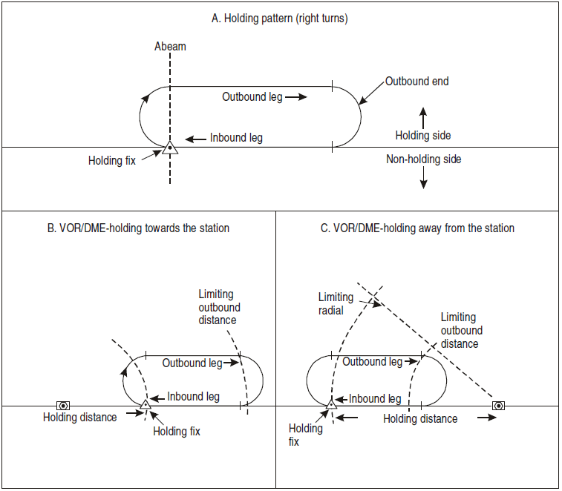
Holding
Parttern
elements

Slide 10
What is the use of Minimum Sector Altitude?
最低扇区高度 （MSA） 一、扇区的范围及划分方法 最低扇区高度（MSA:Minimum Sector Altitude） 也称扇区最低安全高度，是紧急情况下所在扇区可以使用的最 低高度。它也是确定仪表进近程序起始高度的一个依据。每个 已建立仪表进近程序的机场都应规定最低扇区高度。 扇区必须以用于仪表进近所依据的归航台为中心，46km （25NM）为半径所确定的区域内。 扇区的划分通常与罗盘象限一致，即根据0°、90°、180°和 270°向台磁航向分为四个扇区。 如果由于地形或其他条件，扇区边界也可选择其他方位使之取 得最好的最低扇区高度。 在每个扇区的边界外有一个9km（5NM）的缓冲区。 中国民航大学空中交通管理学院 中国民航大学空中交通管理学院 以VOR/DME或NDB/DME为中心的扇区，可在扇区内另外规 定一个圆形边界（DME弧），将扇区划分为分扇区，在里面 的区域使用较低的MSA。使用的DME弧应选择在10nm~15nm 之间。分扇区之间的缓冲区宽度仍使用9km。 中国民航大学空中交通管理学院 二、最低扇区高度的确定 各扇区的最低扇区高度等于该扇区及其相应缓冲区内最高障 碍物的标高加上一个超障余度，然后以50m向上取整。 平原机场最小超障余度为300m；山区机场的最小超障余度 应予以增加，最大增加至600m。 相邻电台使用联合扇区 多于一个归航台的两扇区合并（两台距离<9km） 同一归航台的两扇区合并（两扇区MSA<100m） 中国民航大学空中交通管理学院 中国民航大学空中交通管理学院

Slide 11
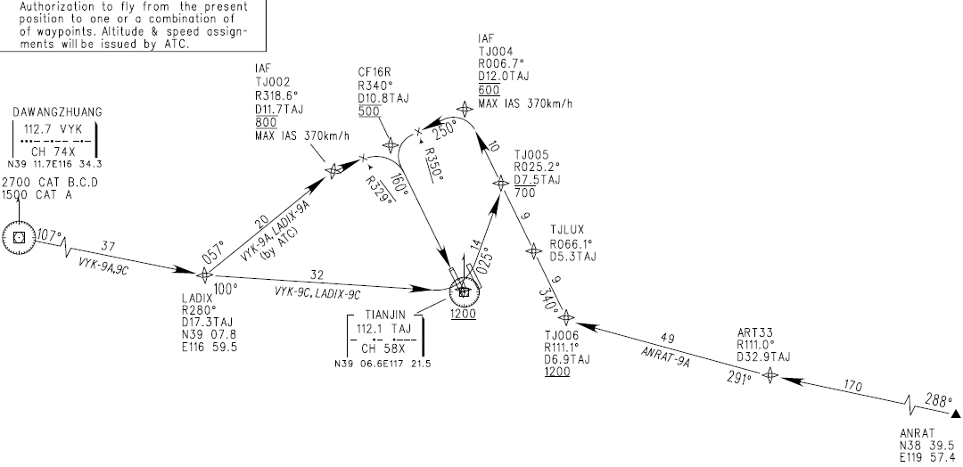
Flight Procedure Examples - Tianjin
Standard Arrival Route/RNAV Runway 16R

Slide 12
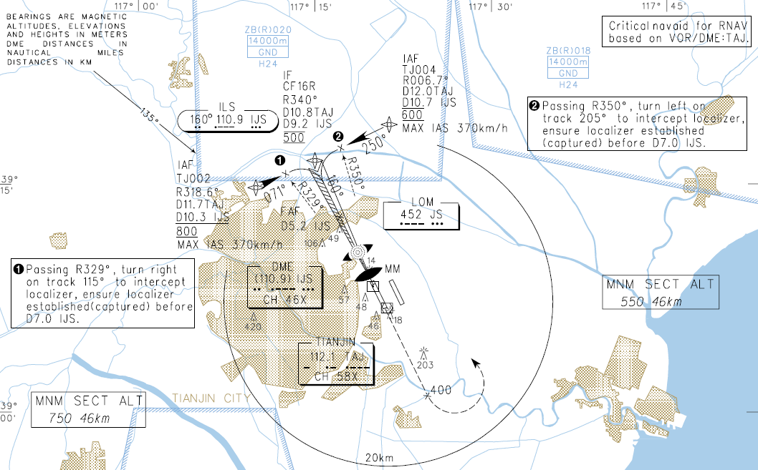
Flight Procedure Examples - Tianjin
Approach /RNAV ILS Runway 16R/Plan view

Slide 13
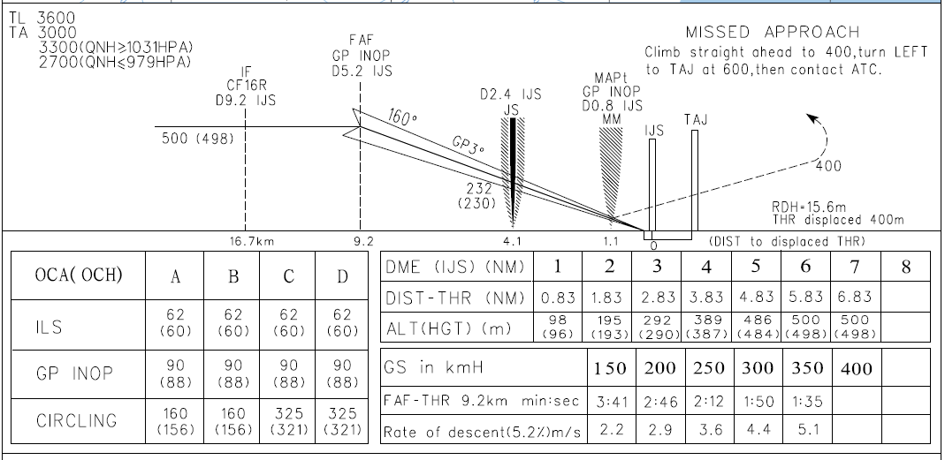
Flight Procedure Examples - Tianjin
Approach /RNAV ILS Runway 16R/Vertical View

